Slide 1
Chapter 11-2. Deviations from the ideal
The measured characteristics deviates slightly from the ideal characteristics discussed. We will discuss some of the non-idealities of the BJT characteristics.
Base-width modulation
Punch-through
Avalanche multiplication and breakdown
Others
  base resistance, depletion region recombination-general

Slide 2
Review: BJT in “cut-off”
E B C
n_{C0}
n_{E0}
p_{B0}

Slide 3
Review: BJT in saturation
E B C
n_{C0}
n_{E0}
p_{B0}

Slide 4
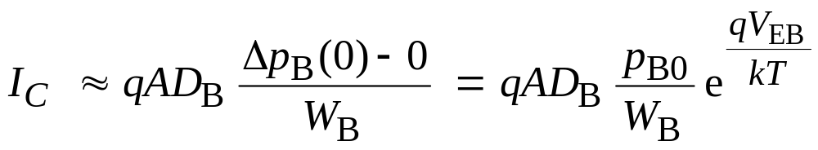
Base width modulation
W
B
E
C
W_{B}
Emitter
Base
Collector
p_{B}(0)
n_{E}(0)
p_{B0}
n_{C0}
n_{E0}
n_{C}(0)

Slide 5
Base width modulation
When the reverse bias applied to the C-B junction increases,
the C-B depletion width increases and W decreases. Thus, the
collector current, I_{C} increases. This is also known as “Early
Effect”. More prominent in narrow-base transistors.
I_{C}
3μA
3 mA
2μA
2 mA
1 mA
1μA
0
V_{EC1}
V_{EC}

Slide 6
Punch-through
Punch-through can be viewed as base width modulation carried
to the extreme, i.e., punch-through occurs when W → 0. For
C-B voltage beyond punch-through, the E-B barrier lowers and
results in large increase in carrier injection from emitter to
collector.
Large increase in collector currents at high V_{CE0} occurs due
to two reasons:
Punch-through or
Avalanche multiplication

Slide 7
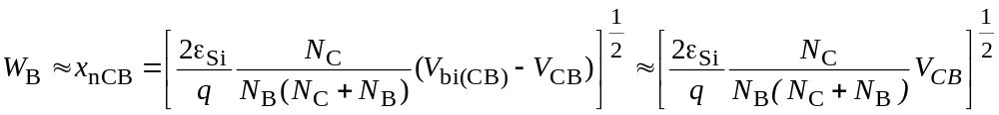
Example 1
W_{B}
W_{B}
10¹⁹ 10¹⁶ 10¹⁶
10¹⁹ 10¹⁵ 10¹⁶
BJT 1
BJT 2
Two transistors are identical except that the base doping is
different.
A. Which transistor will have higher base-width-modulation effect?
B. Which one will have higher punch-through voltage?
Approximate value of punch-through voltage can be obtained by equating the depletion layer width on the base side to the base-width, W_{B}.

Slide 8
Other effects
Base series resistance
Current crowding
Recombination-generation current
Modern BJT structures:
Heterojunction bipolar transistor (HBT)

